Slide 1

ConnectBand
CSPC 473-01 - Project 1

Slide 2
Contributors
Stephen Shinn - smshinn@csu.fullerton.edu
Bennett Lawrenz - Spagecko@csu.fullerton.edu
Samarth Shah - samarth_29@csu.fullerton.edu
Rushiraj Jadeja - rushiraj@csu.fullerton.edu
Jiacheng Li - kyle0775168@csu.fullerton.edu

Slide 3
What is Connect Band?
Connect band is a proof of concept of a social media network centered around a band and their audience.
The scope of this website demo will cover: 1) Installation of the server 2) Configuration of the database 3) User Features 4) Admin Features 5) Future Enhancements

Slide 4
Resources Used to Build Connect Band
XAMPP: to setup/host Apache and MySQL Services
MySQL: as the main database.
AJAX: Redirect control to the server side
JavaScript: for most of the basic coding.
PHP: to communicate between the database and the website
Bootstrap: to find a template that is appropriate for the website

Slide 5
Installation
1. Install the XAMPP environment by going to https://www.apachefriends.org/index.html
2. Once XAMPP is running start MySQL service by clicking start
3. While the service is running PHP Admin should be accessible at http://localhost/phpmyadmin/

Slide 6
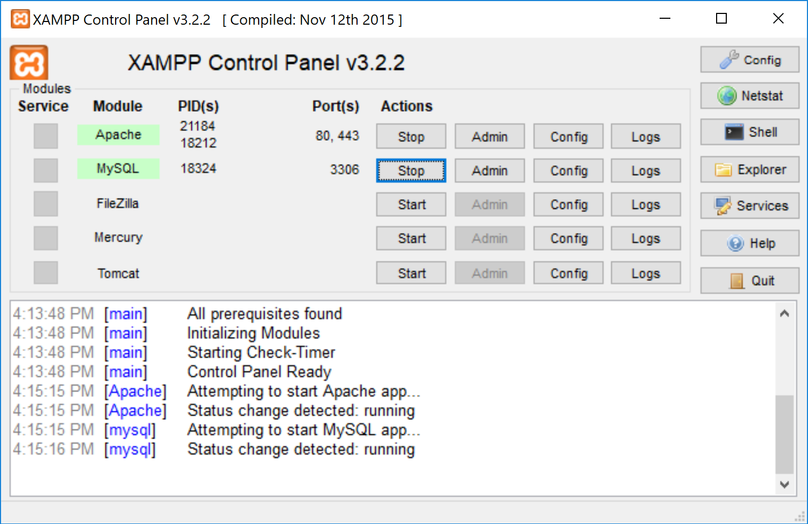
Installation (Cont.)
The control panel should be similar to the following:

Slide 7
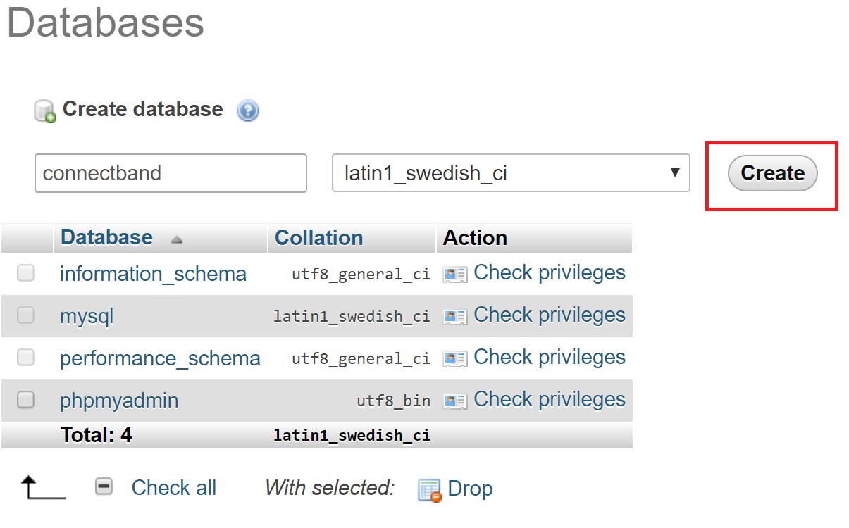
Configuration
Create a database named “connectband” in the database tab of phpmyadmin.

Slide 8
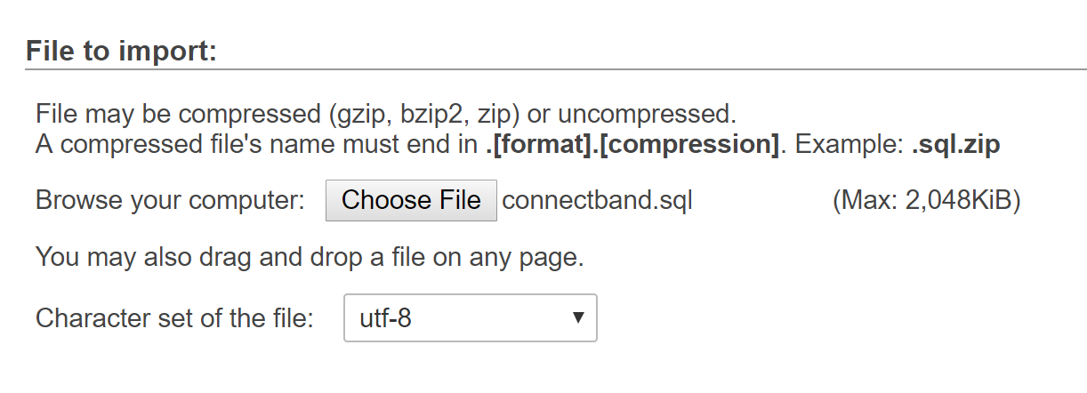
Configuration (Cont.)
2. Download the SQL Script from https://github.com/Spagecko/ConnectBand/blob/master/connectband.sql and import “connectband.sql”.

Slide 9
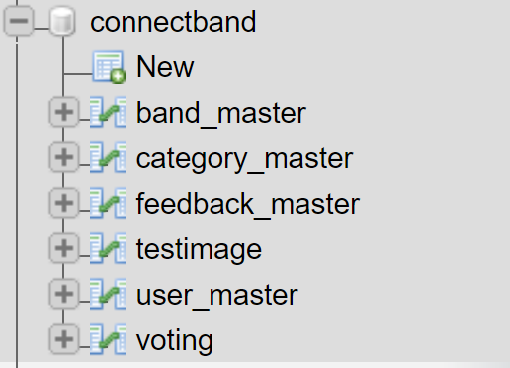
Configuration (Cont.)
3. After completing these steps, the database should be the same as the image below:

Slide 10
Users
Can create accounts
Login/Logout
Submit feedback

Slide 11
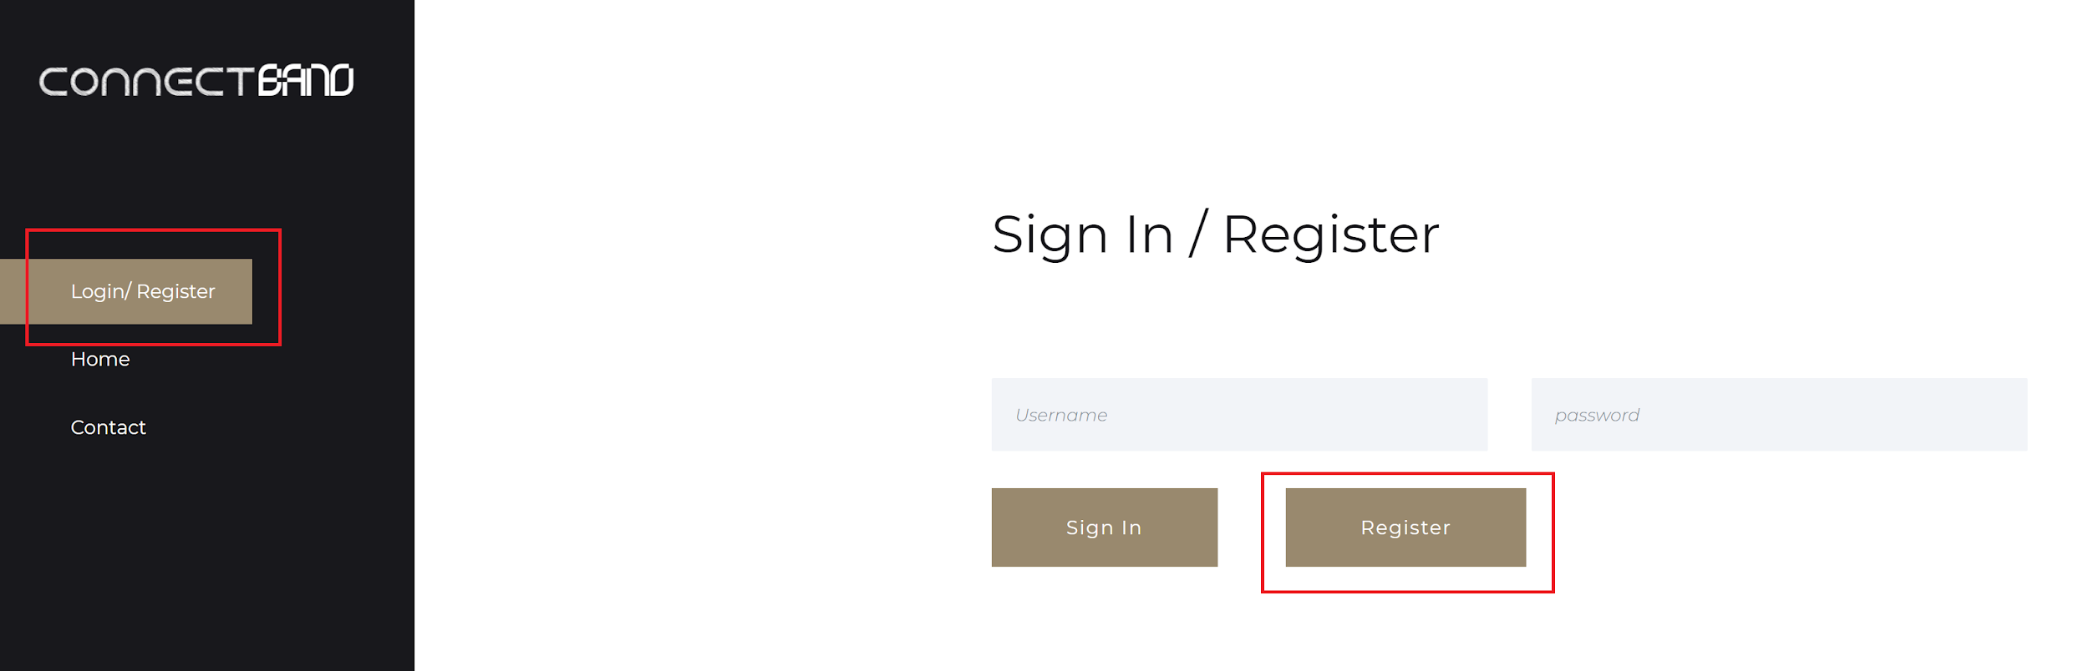
Creating an Account
Click on the Login/Register tab on the left panel and then click the register button.
Fill out the appropriate fields, then click register.

Slide 12
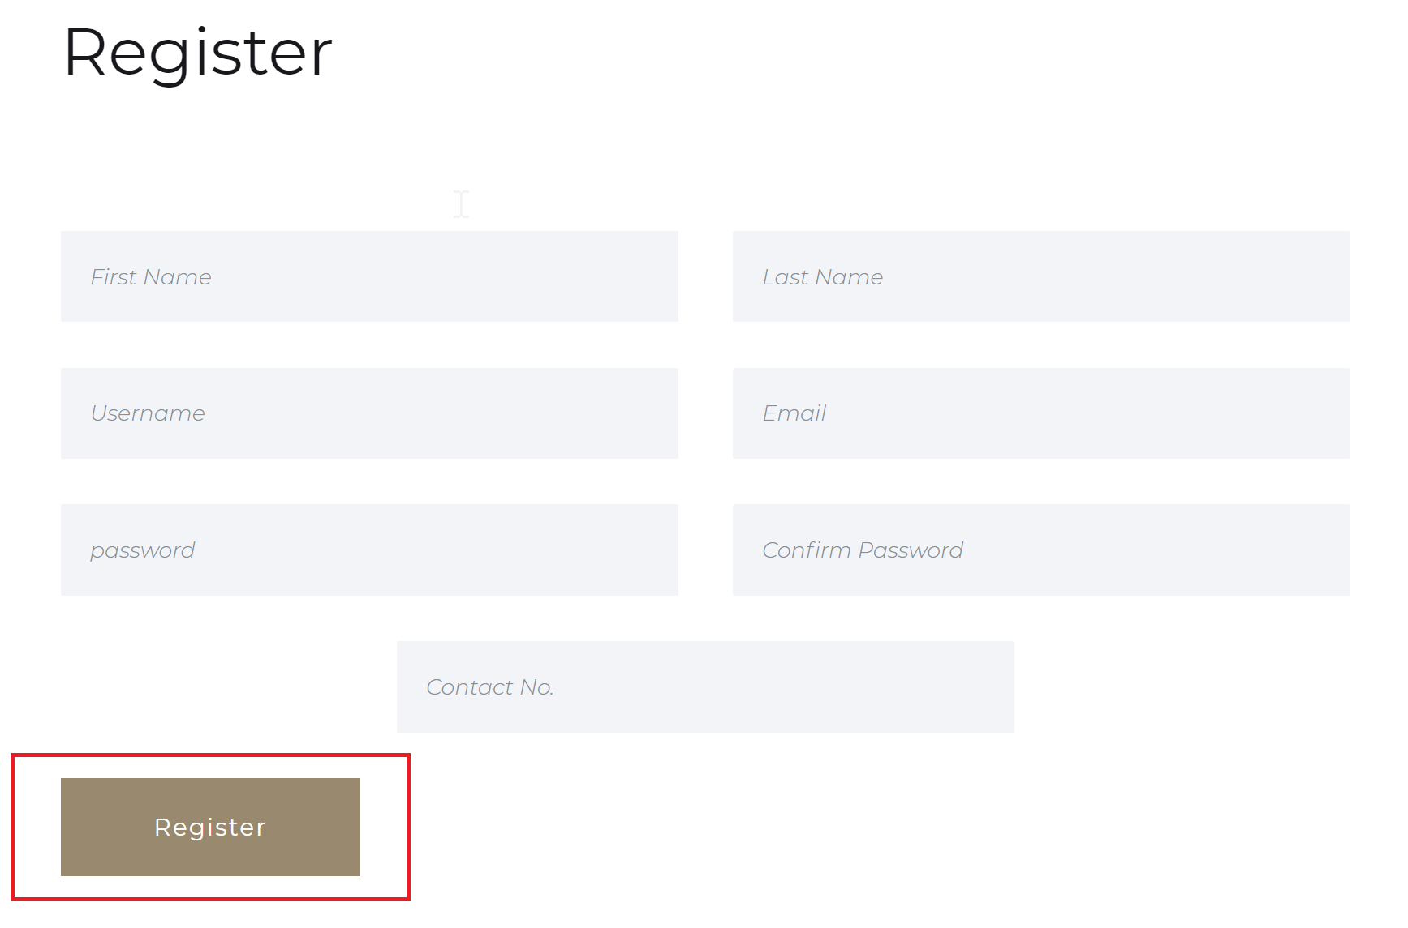
Creating an Account (Cont.)
After filling out the appropriate fields , the username and passwords will be saved and effectively creating a new account

Slide 13
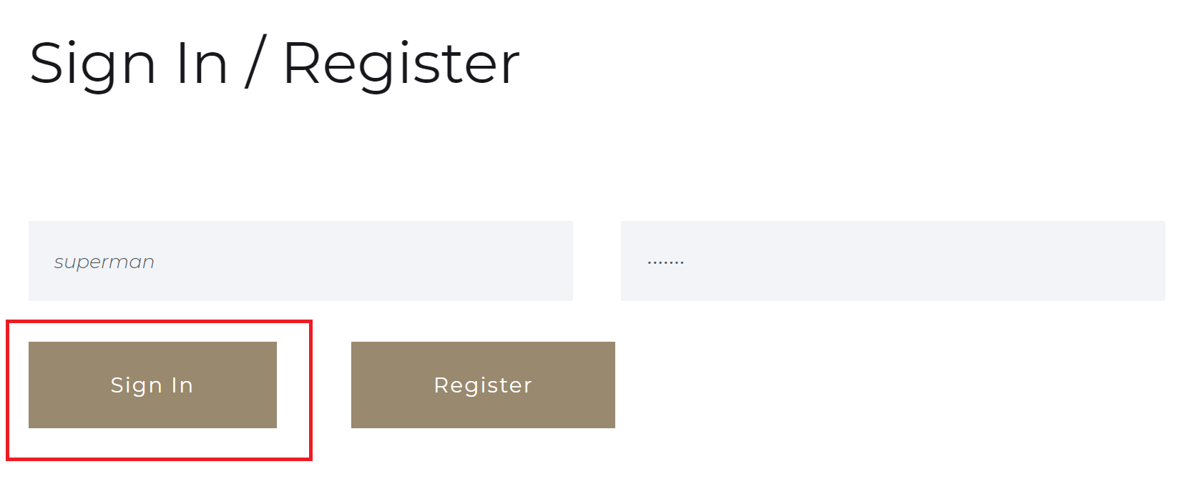
Logging In
To login, fill out the username and password field with a registered account.

Slide 14
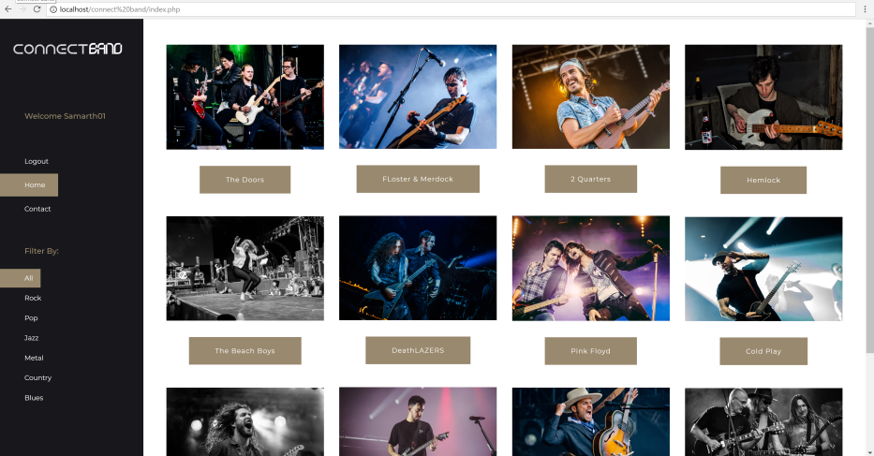
Logging In (Cont.)
A welcome message on the left panel should be displayed with a username indicating that you have been logged in.

Slide 15
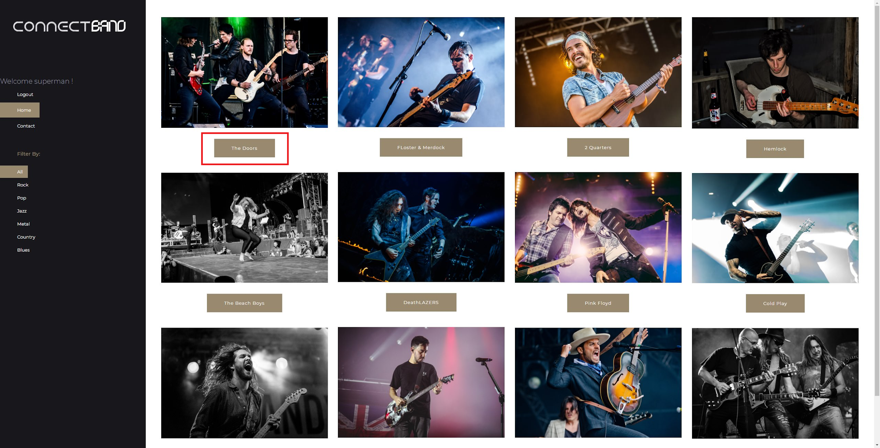
Submitting Feedback
After logging into your account, click on a band name to submit feedback for.

Slide 16
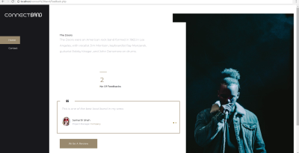
Submitting Feedback (Cont.)
Click on the “Write a Review” button.
In the message box, write a review then press the “Submit Feedback” button.
After submitting, you will be sent back to the home page.

Slide 17
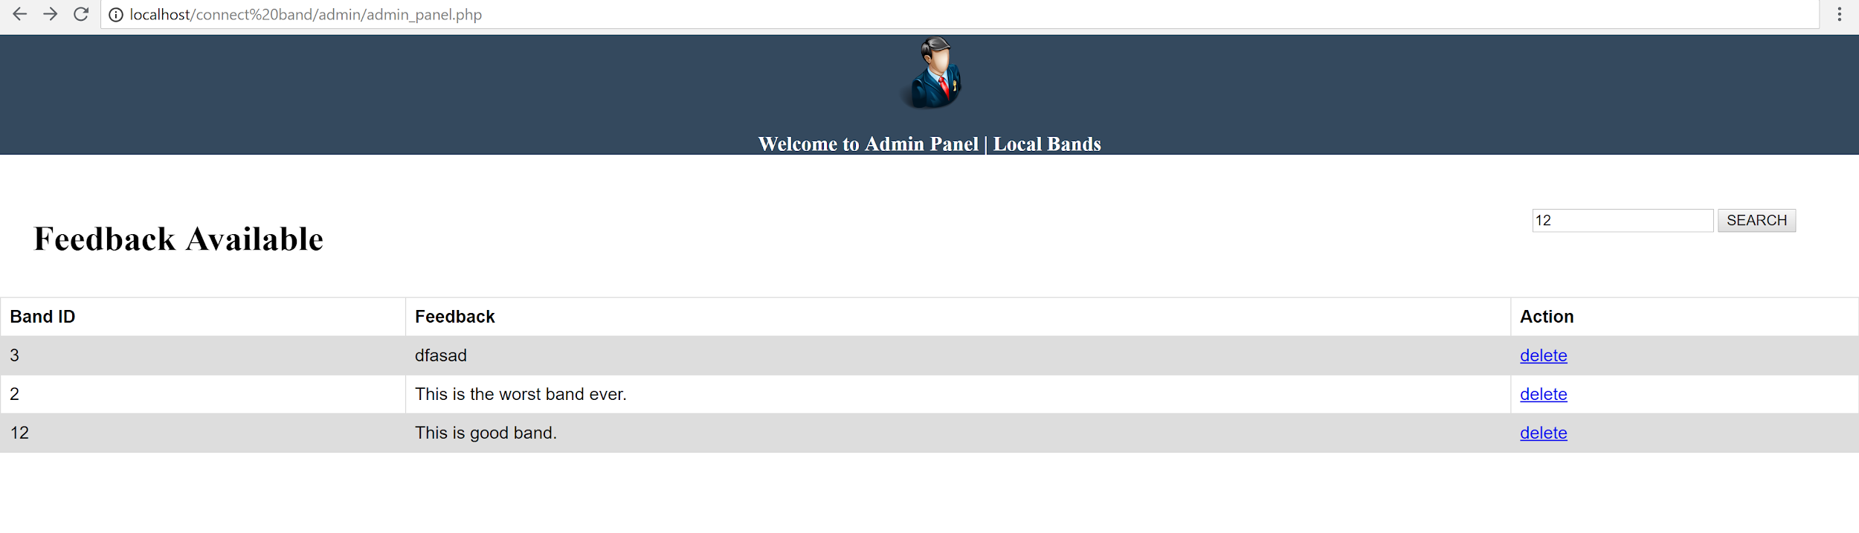
Admin
Deleting Feedback 1.Login as admin 2. Select feedback to delete from database

Slide 18
Functionality
Filter by Genre
Contact Us

Slide 19
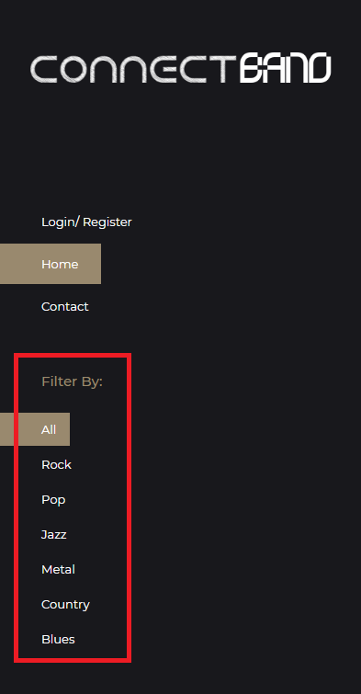
Filter by Genre
On the left panel of the site, users can select filters according to music genre.

Slide 20
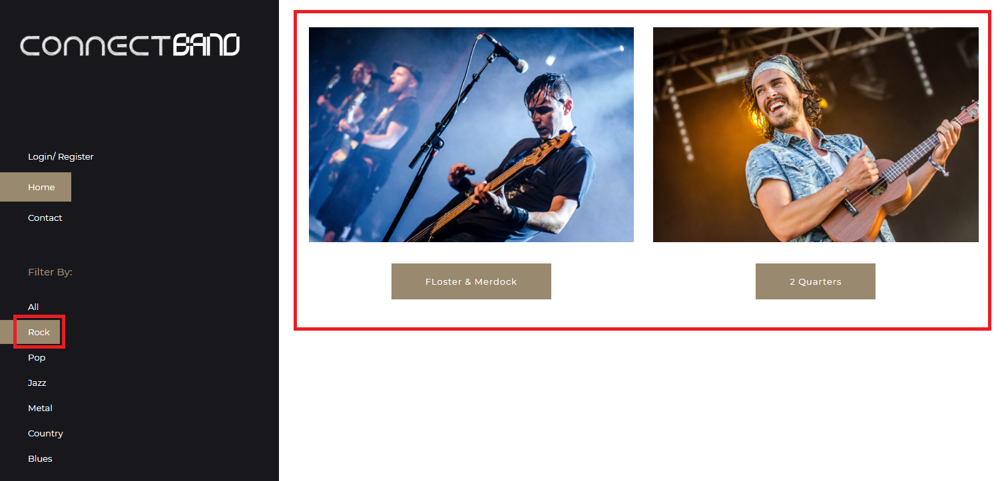
Filter by Genre (cont.)
Clicking any one of the categories should filter out the bands.

Slide 21
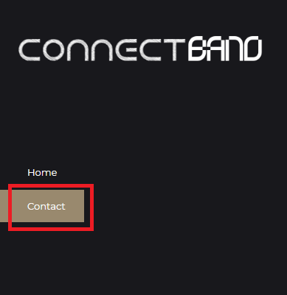
Contact Us
On the left panel of the site, click on the “Contact” button

Slide 22
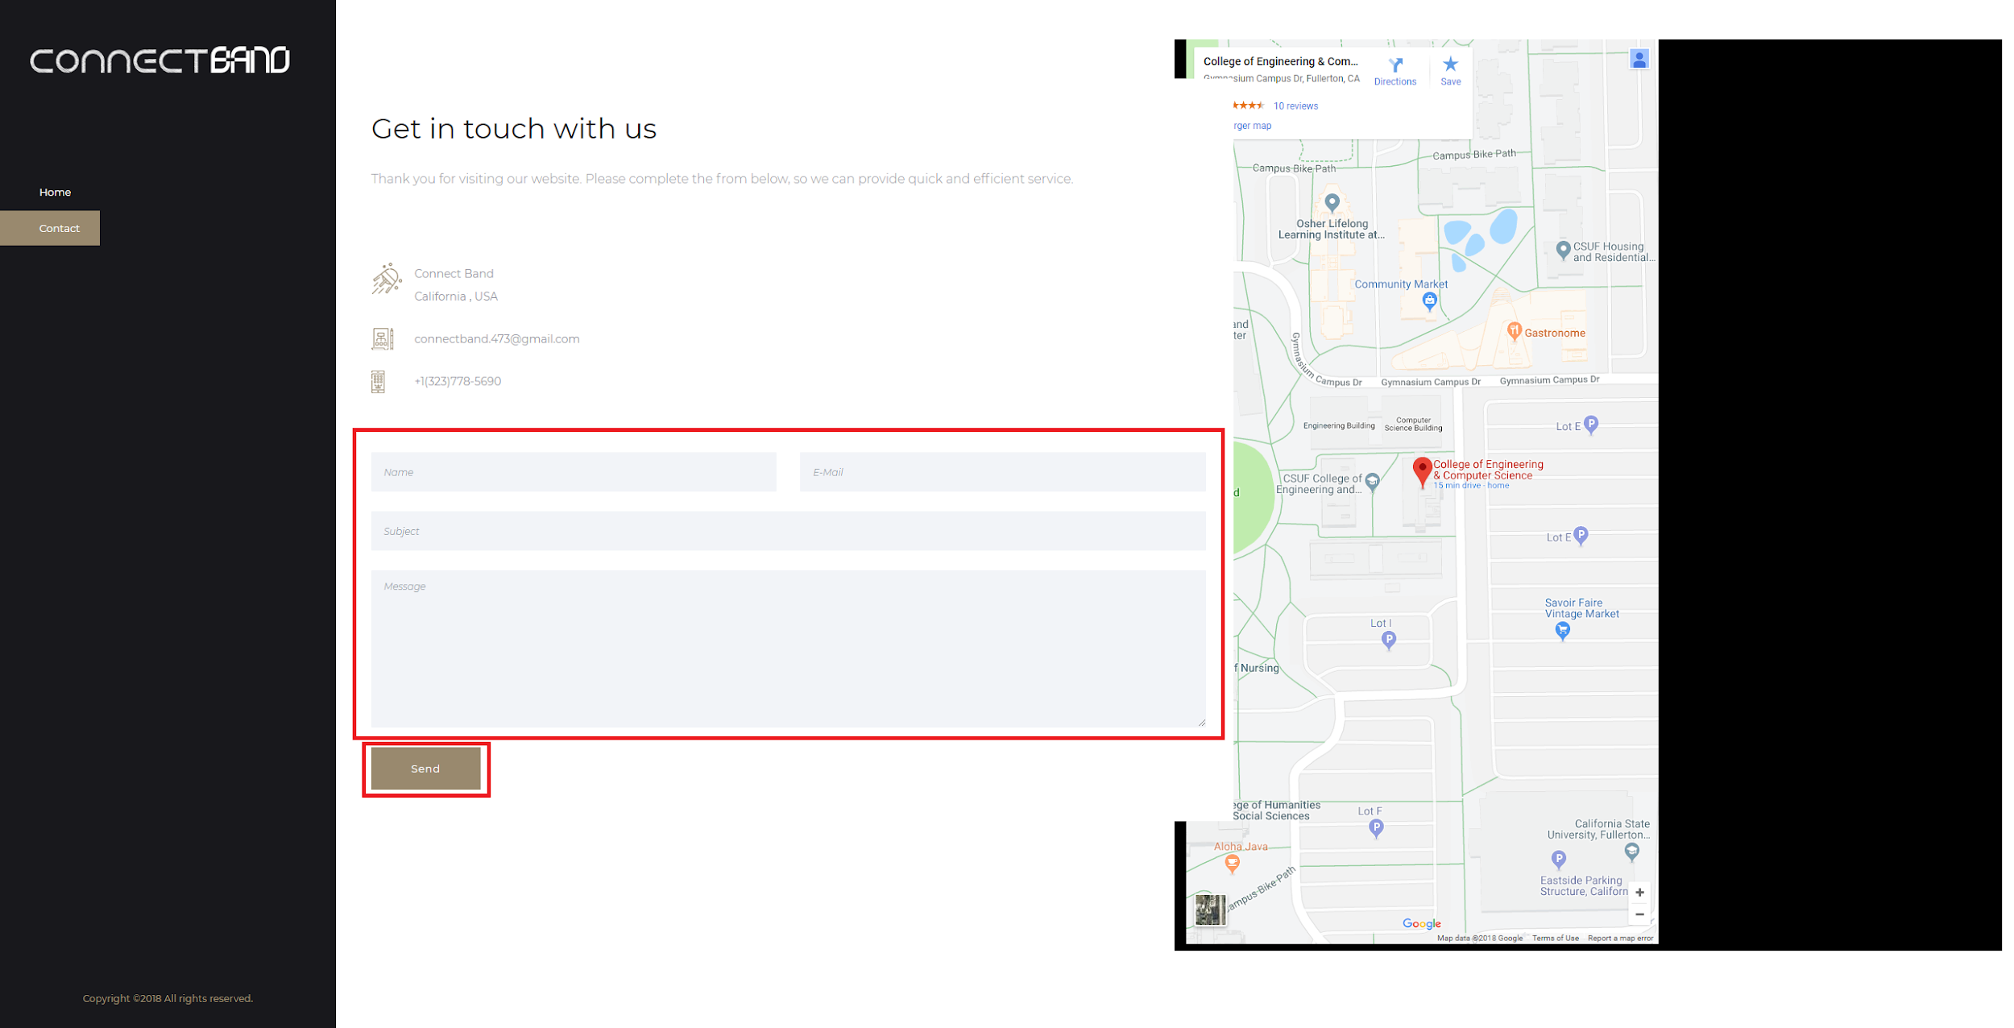
Contact Us (Cont.)
Fill out the appropriate fields and click the “Send” button.

Slide 23
DEMO
A demo will be shown now.

Slide 24
Upcoming Features
Verified reviews: Reviews will have a check mark next to the user’s name.
Band Subscribe: If a user wishes to attend to a certain performances show again users can subscribe to a band and be notify when the band is play near the users area.
Band Reach: Bands can encourage users to submit feedback and share the band and in return the band and send out coupons for band merchandise
Party Rooms: Live chat rooms of a show. Attendees who are at the show can use the chatroom for free while users who are unable to attend can subscribe to the live feed for a premium cost.
Band Photo Walls: Users can submit and performers can share their favorite moments on the bands homepage

Slide 25
The End
Any Questions or comments?

